Slide 1



IMPROVING THE DETECTION AND CHARACTERIZATION OF STANDING ACCRETION SHOCK INSTABILITY USING GRAVITATIONAL WAVES
-DR ZANOLIN-
-MIRIAM BIEHLE-

Slide 2
Special Thanks
-ERAU URI-
-NASA SPACE GRANT-
-DR ZANOLIN-
-DR MUKHERJEE-
-DR SZCZEPAŃCZYK-
-GAUKHAR NURBEK-
-KYA SCHLUTERMAN-
Supported in part through the Arizona NASA Space Grant Consortium, Cooperative Agreement 80NSSC20M0041.

Slide 3
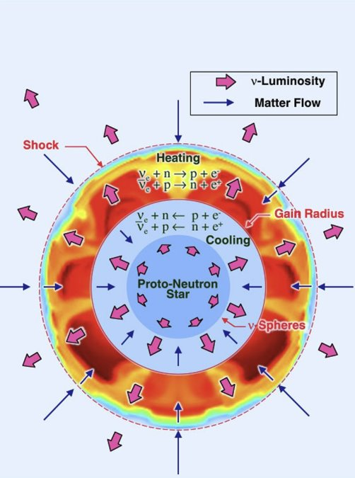
IMPROVING THE DETECTION AND CHARACTERIZATION OF SASI
SASI in Core Collapse Supernovae
Core Collapse Supernovae occur when a super massive star undergoes nuclear fusion developing a dense iron core.
When this iron core reaches 1.4M☉ it collapses on itself and rebounds creating a shockwave through the newly formed proto neutron star's accreting material.
This shockwave can stall creating what is known as SASI.
Image credit: Colter Richardson LVK Burst Call
Notes:
General introduction slide

Slide 4
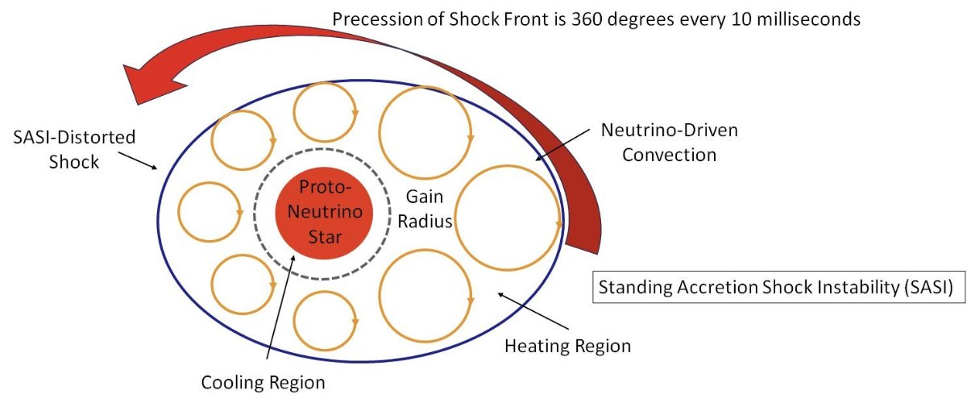
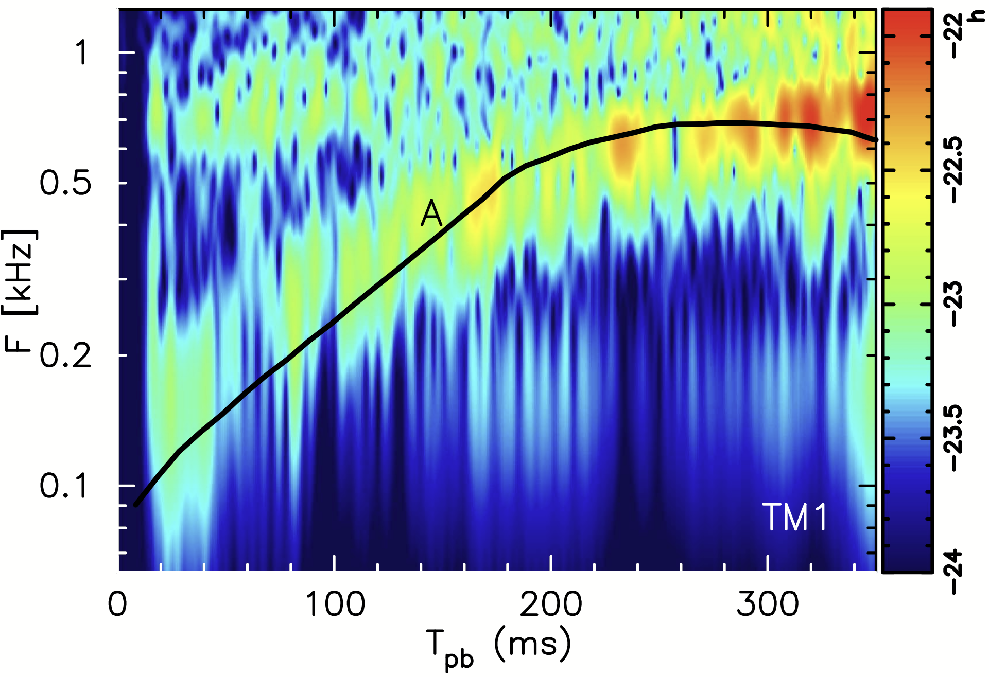
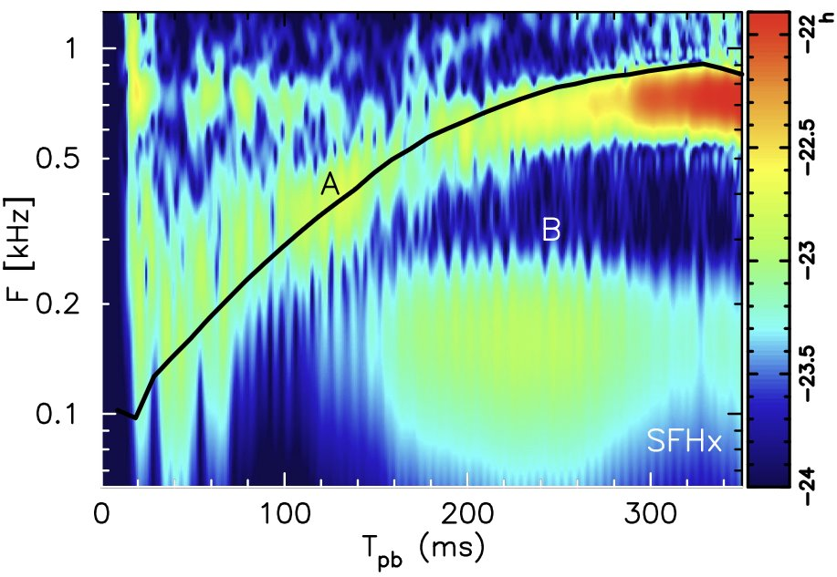
What is SASI?
INTRODUCTION
Standing Accretion Shock Instability
Caused by interactions between accreting material and the stalled shock front forming a precession around the proto-neutron star
Theoretically gravitational waves can be used to detect these rare events.
Image credit: Colter Richardson LVK Burst Call
https://iopscience.iop.org/article/10.3847/2041-8205/829/1/L14/pdf
Notes:
Full text slide

Slide 5
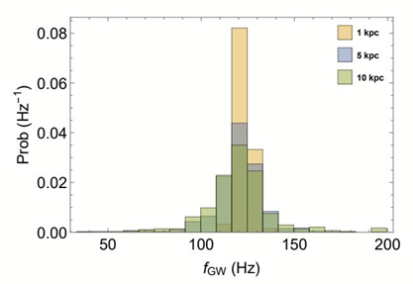
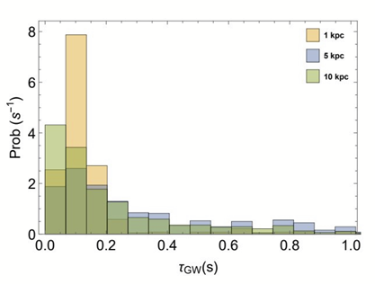

Purpose
METHODS AND REASONING
The amplitude, duration, and frequency of the SASI detection can provide this key information.
SASI has been linked to playing a key role in
Exploding models
Understanding the structure of supernovae
The mechanism of black hole and neutron star formation
https://doi.org/10.1007/978-981-15-4702-7_21-1
https://doi.org/10.1103/PhysRevD.107.083017
Notes:
Full text slide

Slide 6
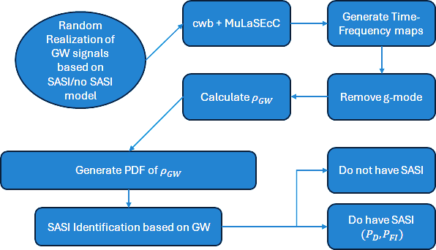
Methods
METHODS AND REASONING
The processed waveforms can then be analyzed using SASI-meter
Models of core collapse supernovae are produced in high performance computing environments.
The signals from these models are injected into real laser interferometric noise from LIGO.
The signals are then processed through pipelines.
Edited from: https://doi.org/10.1103/PhysRevD.107.083017
Notes:
Full text slide

Slide 7
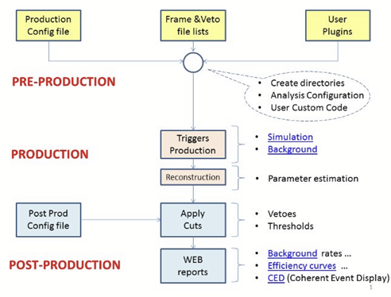
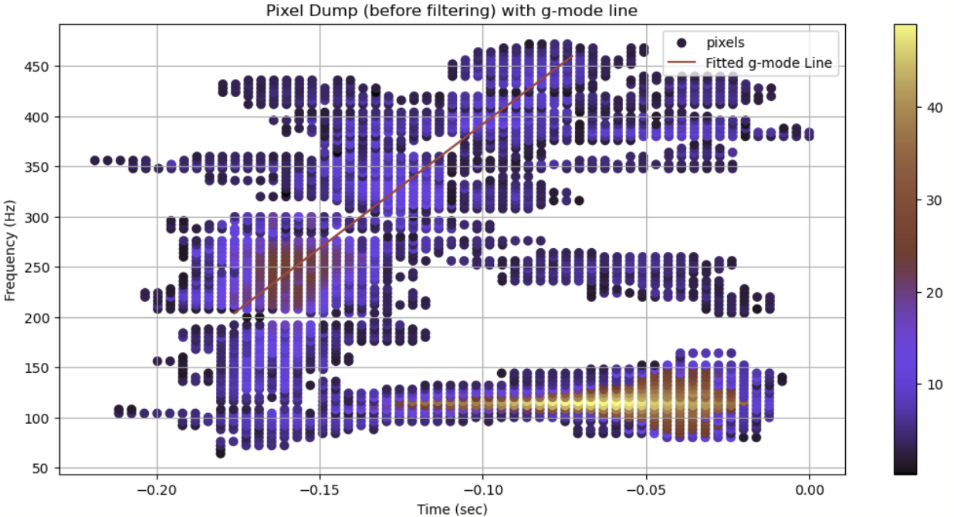
CWB XP
PROGRAMS
https://gwburst.gitlab.io/documentation/latest/html/flowchart.html
coherent Wave Burst (Cross-Power)
Event generation software using wavelet decomposition
Updated in 2023 to better detect gravitational waves from core collapse supernovae
Notes:
Full text slide

Slide 8
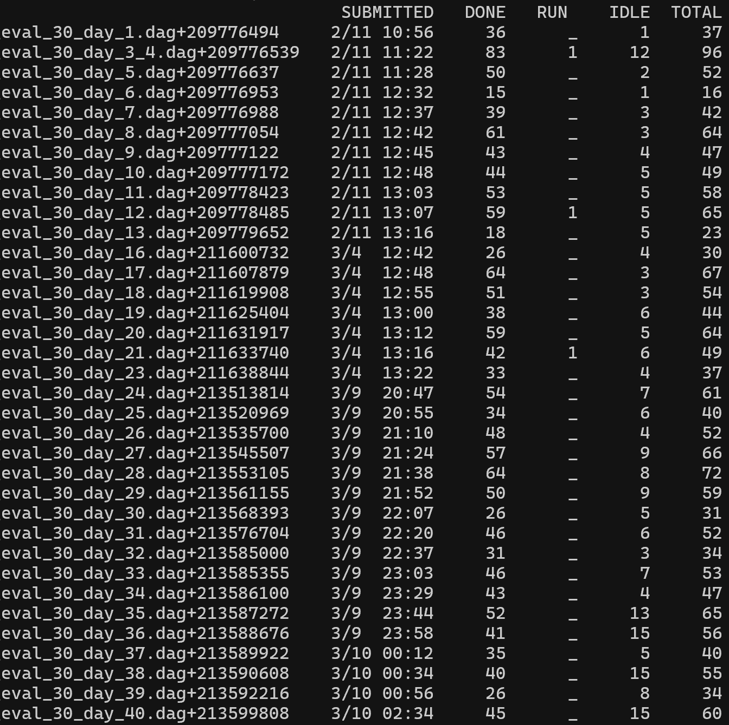
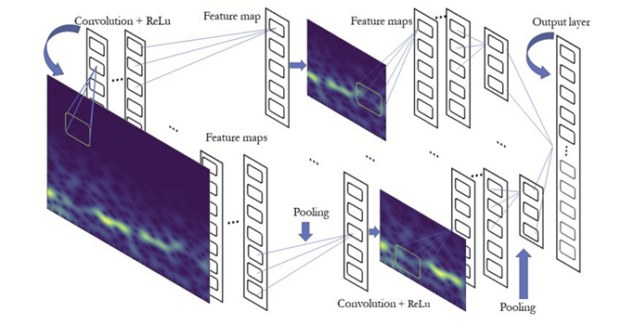
MuLaSEcC
PROGRAMS
Multi-Layer Signal Enhancement with coherent Wave Burst and Convolutional Neural Network
A machine learning based pipeline used to enhance a signal from the LIGO noise.
This would be an incredible addition to the analytical process
https://gwburst.gitlab.io/documentation/latest/html/flowchart.html
Notes:
Full text slide

Slide 9
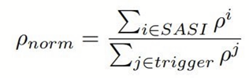
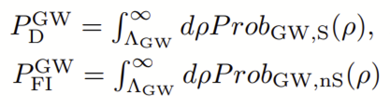
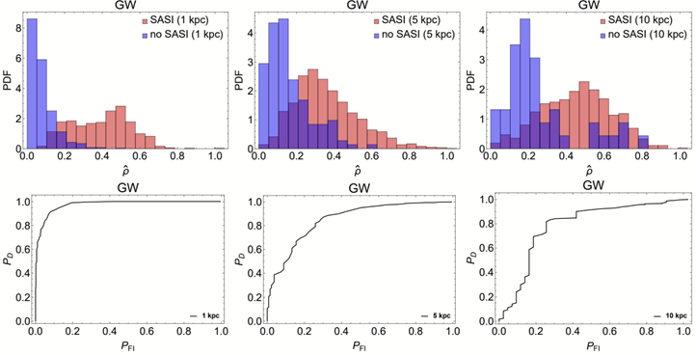
SASI-meter
PROGRAMS
Creates Time-Frequency Plots from reconstructed waveforms with and without SASI
Produces probabilities of detection of the SASI Component
Currently in development
https://doi.org/10.1103/PhysRevD.107.083017
Notes:
Full text slide

Slide 10
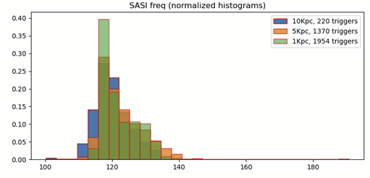
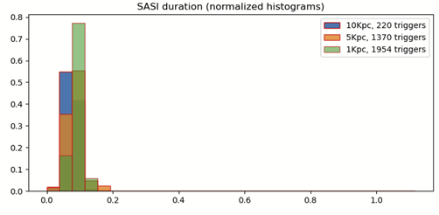
Current Results
RESULTS
The results previously achieved have now been reached using the new methods at a distance one order of magnitude greater.
Jobs are now being run with MuLaSEcC
Plans are made to work with Dr. Szczepańczyk to develop an online version of SASI-meter
Notes:
Full text slide

Slide 11
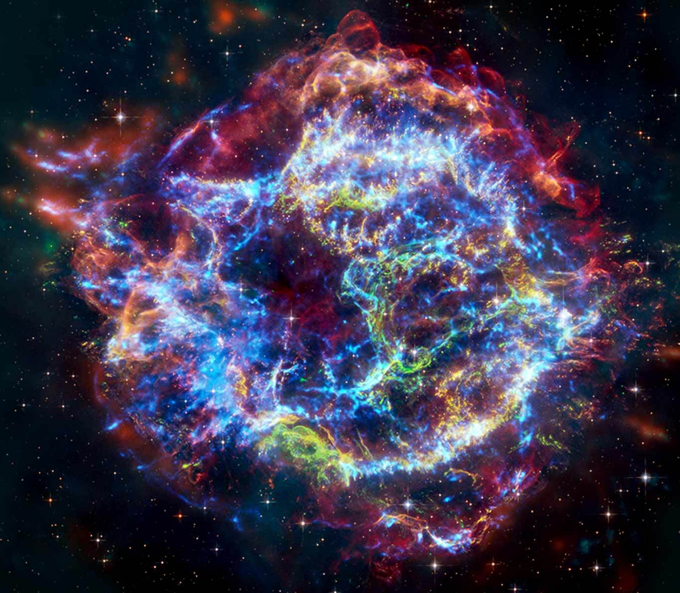
The Future of Detection
RESULTS
Replicate graphs produced by the previous iterations of the SASI-meter program.
Include neutrino-based detection in future paper.
Using the new detection methods, find evidence of SASI from core collapse supernovae in observed gravitational waves
https://chandra.harvard.edu/photo/2024/casa/
Notes:
Full text slide

